Slide 1
Misconceptions about betatron coupling in storage-ring-based light sources
Andrea Franchi (ESRF, Grenoble)
Workshop on NOnlinear dynamics and Collective Effects in particle beam physics, NOCE2017, Arcidosso, Italy, 19th to 22th September 2017

Slide 2
Outlines
Misconception #1: In the presence of coupling we deal with vertical emittances (plural is not a typo)
Misconception #2: Coupling correction is a linear problem not needing CPU-intense random/genetic/non-linear optimizers
Misconception #3: Guignard formulas do not apply to modern synchrotron light sources and damping rings
Misconception #4: “indirect measurements” of vertical emittance should be avoided

Slide 3
Outlines
Misconception #1: In the presence of coupling we deal with vertical emittances (plural is not a typo)
Misconception #2: Coupling correction is a linear problem not needing CPU-intense random/genetic/non-linear optimizers
Misconception #3: Guignard formulas do not apply to modern synchrotron light sources and damping rings
Misconception #4: “indirect measurements” of vertical emittance should be avoided

Slide 4
Vertical emittance in the absence of coupling
Misconception #1: on the vertical emittances
Eigen-emittance E: constant along the ring, with Ev≅0

Slide 5
Vertical emittance in the absence of coupling
Misconception #1: on the vertical emittances
Eigen-emittance E: constant along the ring, with Ev≅0
Non measurable RMS emittance:

Slide 6
Vertical emittance in the absence of coupling
Misconception #1: on the vertical emittances
Eigen-emittance E: constant along the ring, with Ev≅0
Non measurable RMS emittance:
Measurable emittance from RMS beam size:

Slide 7
Vertical emittance in the absence of coupling
Misconception #1: on the vertical emittances
Eigen-emittance E: constant along the ring, with Ev≅0
Non measurable RMS emittance:
Measurable emittance from RMS beam size:
Ev=εy=Ey=const.
With zero vertical dispersion, Ev=εy=Ey≅0

Slide 8
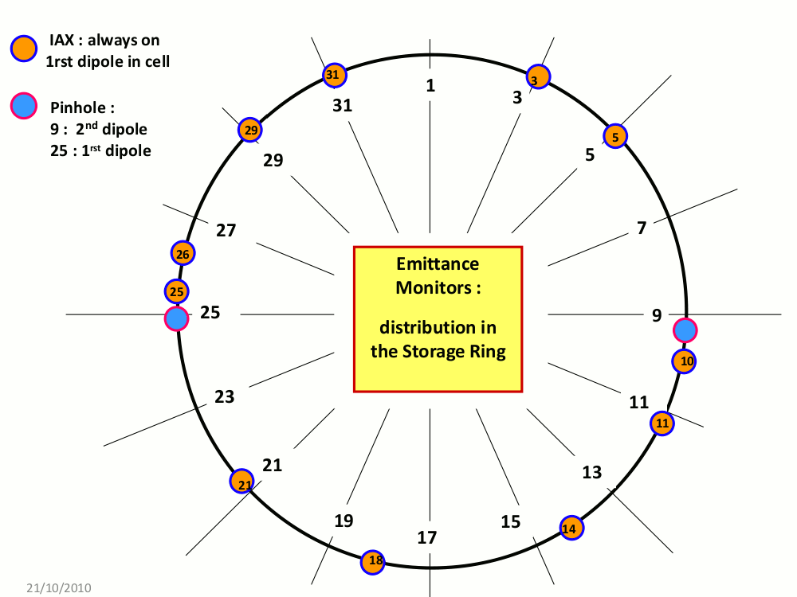
Meas. vertical emittance Ey from RMS beam size
Misconception #1: on the vertical emittances
ESRF SR equipment:
11 dipole radiation projection monitors (IAX)
2 pinhole cameras

Slide 9
Meas. vertical emittance Ey from RMS beam size
Misconception #1: on the vertical emittances
Ex=4.2 nm
Well corrected coupling
Low beam current (20 mA)
3.3 pm
1.8 pm
4.2 pm
5.5 pm
3.7 pm
2.3 pm
2.8 pm
3.6 pm
1.0 pm
2.8 pm
1.4 pm

Slide 10
Meas. vertical emittance Ey from RMS beam size
Misconception #1: on the vertical emittances
Ex=4.2 nm
Well corrected coupling
Low beam current (20 mA)
Εy=3.0 pm
±1.3
3.3 pm
1.8 pm
4.2 pm
5.5 pm
3.7 pm
2.3 pm
2.8 pm
3.6 pm
1.0 pm
2.8 pm
1.4 pm

Slide 11
Meas. vertical emittance Ey from RMS beam size
Misconception #1: on the vertical emittances
Ex=4.2 nm
Uncorrected coupling
Low beam current (20 mA)
Εy=46 pm
±18
40 pm
46 pm
41 pm
31 pm
79 pm
79 pm
36 pm
39 pm
44 pm
49 pm
26 pm

Slide 12
Meas. vertical emittance Ey from RMS beam size
Misconception #1: on the vertical emittances
Ex=4.2 nm
Uncorrected coupling
Low beam current (20 mA)
Εy=46 pm
±18
The spread among vertical emittance measurements along the ring increases with coupling (from 1.3 pm to 18 pm). Why?
40 pm
46 pm
41 pm
31 pm
79 pm
79 pm
36 pm
39 pm
44 pm
49 pm
26 pm

Slide 13
Vertical emittance in the absence of coupling
Misconception #1: on the vertical emittances
Eigen-emittance E: constant along the ring, with Ev≅0
Non measurable RMS emittance:
Measurable emittance from RMS beam size:
Ev=εy=Ey=const.
With zero vertical dispersion, Ev=εy=Ey≅0

Slide 14
Vertical emittances in the presence of coupling
Misconception #1: on the vertical emittances
Eigen-emittance E: constant along the ring, but Ev≠0
Non measurable projected s-dependent RMS emittance:
Measurable apparent s-dependent emittance from RMS beam size:

Slide 15
Vertical emittances in the presence of coupling
Misconception #1: on the vertical emittances
Eigen-emittance E: constant along the ring, but Ev≠0
Non measurable projected s-dependent RMS emittance:
Measurable apparent s-dependent emittance from RMS beam size:
Ev=const ≠ εy(s) ≠ Ey(s)

Slide 16
Vertical emittances in the presence of coupling
Misconception #1: on the vertical emittances
Coupling sources (tilted quads, misaligned sextupoles, ID error fields, etc.) generate skew quad fields J₁(s)

Slide 17
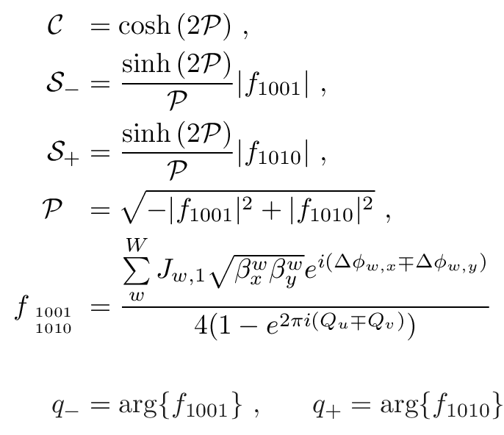
Vertical emittances in the presence of coupling
Misconception #1: on the vertical emittances
Coupling sources (tilted quads, misaligned sextupoles, ID error fields, etc.) generate skew quad fields J₁(s)

Slide 18
Vertical emittances in the presence of coupling
Misconception #1: on the vertical emittances
Coupling sources (tilted quads, misaligned sextupoles, ID error fields, etc.) generate skew quad fields J₁(s)
J₁(s) generate two Resonance Driving Terms (RDTs) f(s)
f_{a}=M_{ab}(β,φ) J_{b,1}
Linear dependence!

Slide 19
Vertical emittances in the presence of coupling
Misconception #1: on the vertical emittances
Coupling sources (tilted quads, misaligned sextupoles, ID error fields, etc.) generate skew quad fields J₁(s)
J₁(s) generate two Resonance Driving Terms (RDTs) f(s)
f_{a}=M_{ab}(β,φ) J_{b,1}
Linear dependence!

Slide 20
Vertical emittances in the presence of coupling
Misconception #1: on the vertical emittances
Coupling sources (tilted quads, misaligned sextupoles, ID error fields, etc.) generate skew quad fields J₁(s)
J₁(s) generate two Resonance Driving Terms (RDTs) f(s)
f_{a}=M_{ab}(β,φ) J_{b,1}
Linear dependence!

Slide 21
Vertical emittances in the presence of coupling
Misconception #1: on the vertical emittances
Non measurable projected s-dependent emittance
Measurable apparent s-dependent emittance

Slide 22
Vertical emittances in the presence of coupling
Misconception #1: on the vertical emittances
Non measurable projected s-dependent emittance
Measurable apparent s-dependent emittance
Nonlinear dependence on the RDTs and J₁

Slide 23
Vertical emittances in the presence of coupling
Misconception #1: on the vertical emittances
Non measurable projected s-dependent emittance
Measurable apparent s-dependent emittance
Vert. Eigen-emittance Hor. Eigen-emittance

Slide 24
Vertical emittances in the presence of coupling
Misconception #1: on the vertical emittances
Non measurable projected s-dependent emittance
Measurable apparent s-dependent emittance
If |f₁₀₁₀| ~ |f₁₀₀₁| ( i.e. S₊ ~ S₋) [low-emitt. rings] εy(s) ≠ Ey(s)

Slide 25
Vertical emittances in the presence of coupling
Misconception #1: on the vertical emittances
Non measurable projected s-dependent emittance
Measurable apparent s-dependent emittance
If |f₁₀₁₀|<<|f₁₀₀₁| ( i.e. S₊<< S₋) [hadron rings] εy(s) = Ey(s)
[booster rings]

Slide 26
Vertical emittances in the presence of coupling
Misconception #1: on the vertical emittances
Non measurable projected s-dependent emittance
Measurable apparent s-dependent emittance
In absence of coupling C=1, S₋=S₊=0 and Ey=Ev=εy=const

Slide 27
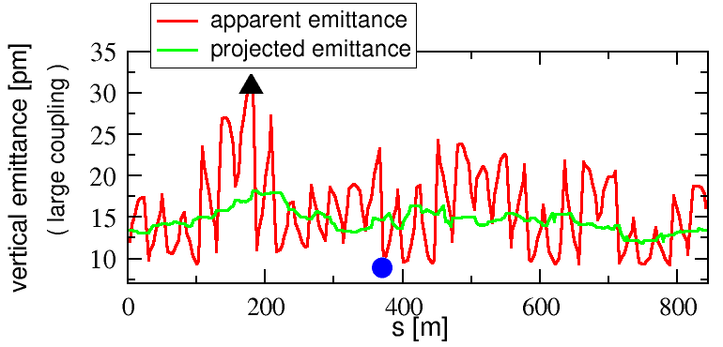
Vertical emittances in the presence of coupling
Misconception #1: on the vertical emittances
Measurable apparent emittance:
Non measurable projected emittance:
Ev= 9 pm
Lattice errors from Orbit Response Matrix measurement + Accel. Toolbox

Slide 28
Vertical emittances in the presence of coupling
Misconception #1: on the vertical emittances
Measurable apparent emittance:
Non measurable projected emittance:
Ev= 9 pm
100% overestimation
40% underestimation

Slide 29
Vertical emittances in the presence of coupling
Misconception #1: on the vertical emittances
Measurable apparent emittance:
Non measurable projected emittance:
Ev= 9 pm
100% overestimation
40% underestimation
300% overestimation Ey(apparent) Vs Ev (equilibrium)

Slide 30
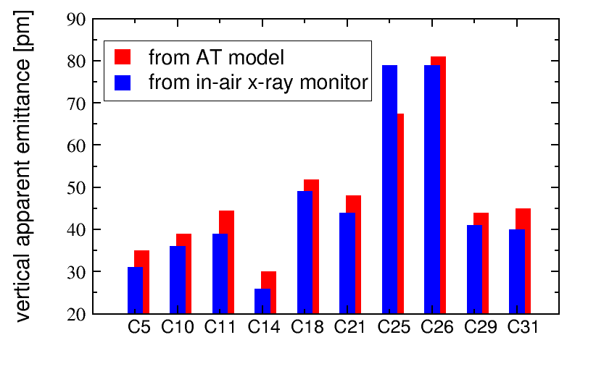
Vertical emittances in the presence of coupling
Misconception #1: on the vertical emittances
Measurable apparent emittance:
Non measurable projected emittance:
Ev= 9 pm
100% overestimation
40% underestimation
300% overestimation Ey(apparent) Vs Ev (equilibrium)

Slide 31
Vertical emittances in the presence of coupling
Misconception #1: on the vertical emittances
Measurable apparent emittance:
Non measurable projected emittance:
Which “vertical emittance” shall we choose, then?
Ev= 9 pm
100% overestimation
40% underestimation
300% overestimation Ey(apparent) Vs Ev (equilibrium)

Slide 32
Vertical emittances in the presence of coupling
Misconception #1: on the vertical emittances
Measurable apparent emittance:
Non measurable projected emittance:
< >
Average over the ring
< >
Ev= 9 pm

Slide 33
Vertical emittances in the presence of coupling
Misconception #1: on the vertical emittances
Measurable apparent emittance:
Non measurable projected emittance:
< >
Average over the ring
< >
Ev= 9 pm

Slide 34
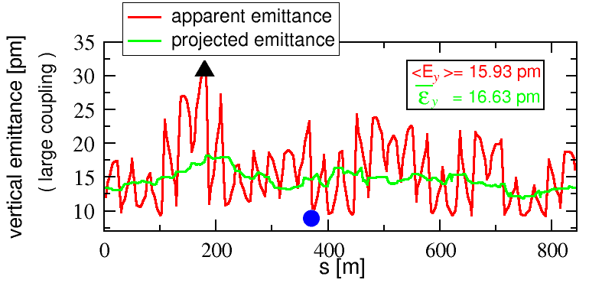
Vertical emittances in the presence of coupling
Misconception #1: on the vertical emittances
Measurable apparent emittance:
Non measurable projected emittance:
< >
Average over the ring
< >
Ev= 9 pm

Slide 35
Vertical emittances in the presence of coupling
Misconception #1: on the vertical emittances
Measurable apparent emittance:
Non measurable projected emittance:
< >
Average over the ring
< >
Ev= 9 pm
Definition of vertical emittance @ ESRF:
More details in PRSTAB-14-012804 (2011)

Slide 36
Outlines
Misconception #1: In the presence of coupling we deal with vertical emittances (plural is not a typo)
Misconception #2: Coupling correction is a linear problem not needing CPU-intense random/genetic/non-linear optimizers
Misconception #3: Guignard formulas do not apply to modern synchrotron light sources and damping rings
Misconception #4: “indirect measurements” of vertical emittance should be avoided

Slide 37
Vertical emittance reduction in the storage ring
Misconception #2: coupling is a linear problem
Coupling (x-y & y-δ) correction @ ESRF SR is carried out with independent skew quadrupoles (V=J₁xy) distributed along the machine.

Slide 38
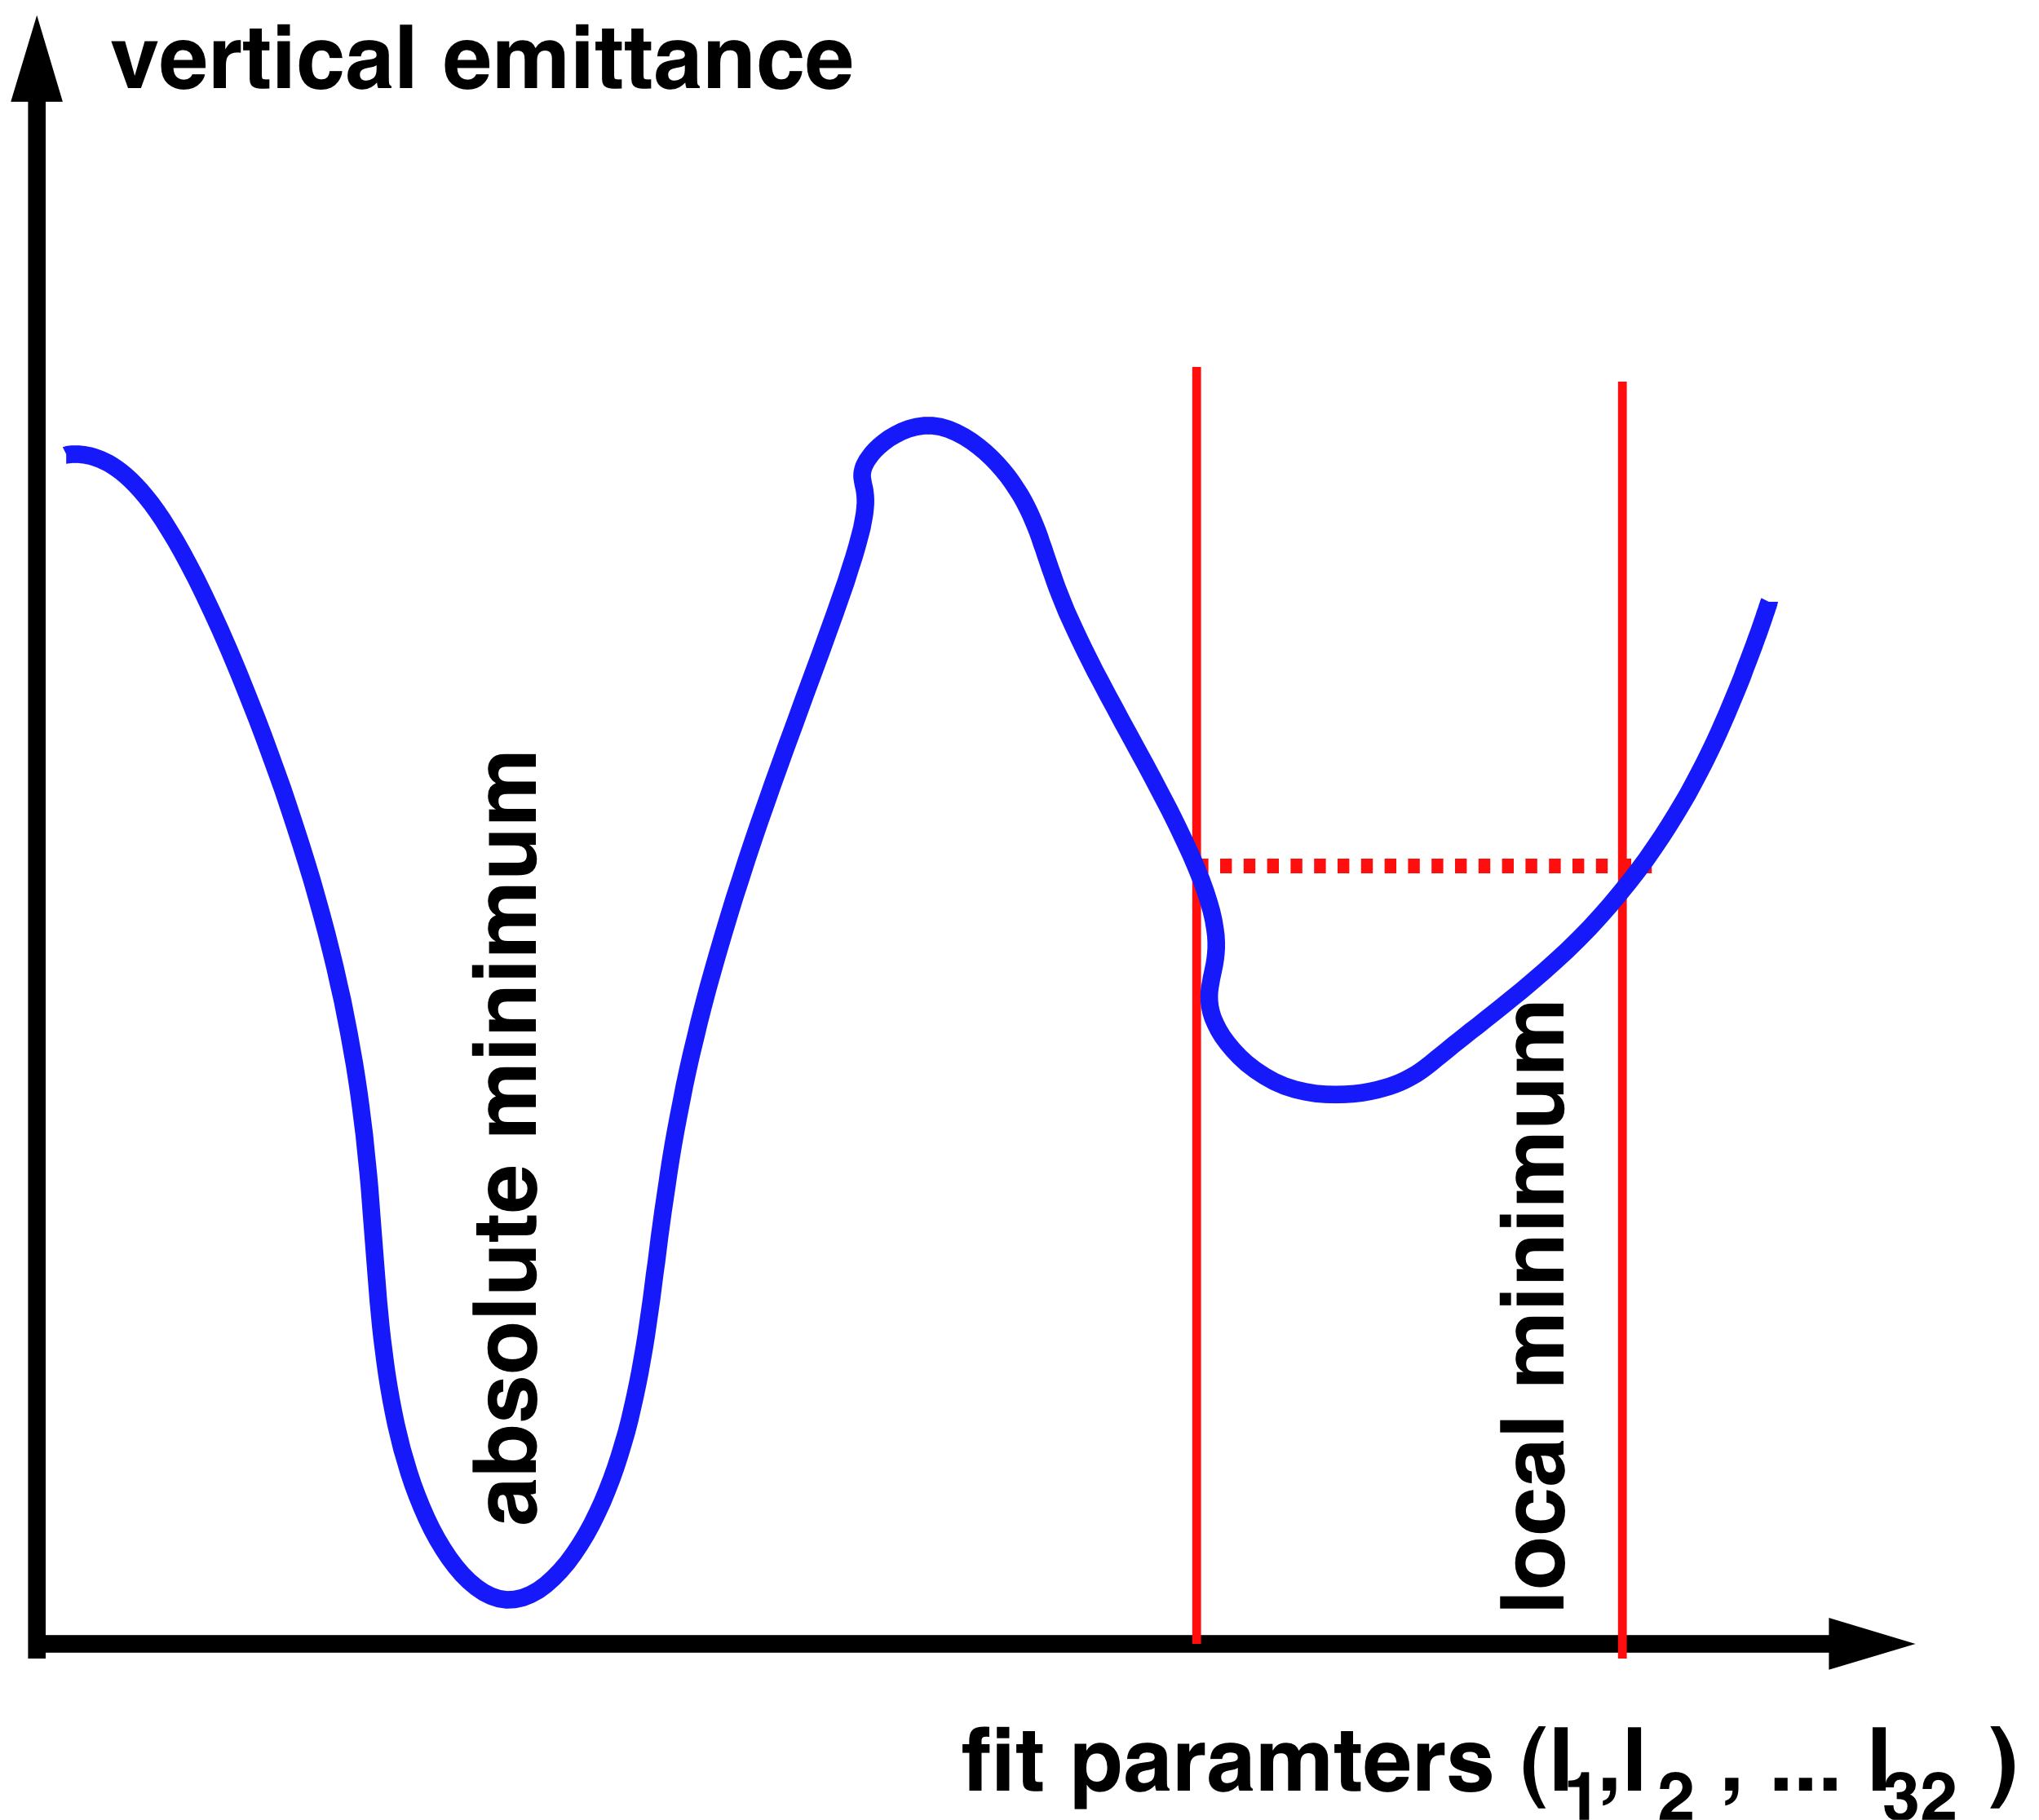
Vertical emittance reduction in the storage ring
Misconception #2: coupling is a linear problem
Coupling (x-y & y-δ) correction @ ESRF SR is carried out with independent skew quadrupoles (V=J₁xy) distributed along the machine.
Until 2009 their currents were computed by trying to minimize the apparent vertical emittance along the machine ➔ non-linear fitting
- time consuming
- may get stuck into a
local minimum value
Details and formulas in PRSTAB-14-012804 (2011)

Slide 39
Vertical emittance reduction in the storage ring
Misconception #2: coupling is a linear problem
Coupling (x-y & y-δ) correction @ ESRF SR is carried out with independent skew quadrupoles (V=J₁xy) distributed along the machine.
As of 2010 their currents are computed by trying to minimize other quantities: Resonance Driving Terms, obtained from orbit measurements (for x-y) and vert. disp. (for y-δ). This automatically minimizes vertical emittance ➔ linear fitting
- faster
- gets directly to absolute minimum value
Details and formulas in PRSTAB-14-012804 (2011)

Slide 40
Coupling correction via Resonance Driving Terms
Misconception #2: coupling is a linear problem
The lower the vertical dispersion and the coupling RDTs, the smaller the vertical emittances

Slide 41
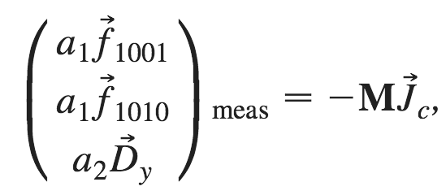
Coupling correction via Resonance Driving Terms
Misconception #2: coupling is a linear problem
The lower the vertical dispersion and the coupling RDTs, the smaller the vertical emittances

Slide 42
Coupling correction via Resonance Driving Terms
Misconception #2: coupling is a linear problem
The lower the vertical dispersion and the coupling RDTs, the smaller the vertical emittances
a₂=0.7 (2010) , 0.4 (2011)
a₁+a₂=1
Different weights on f₁₀₀₁ and f₁₀₁₀ tried, best if equal.

Slide 43
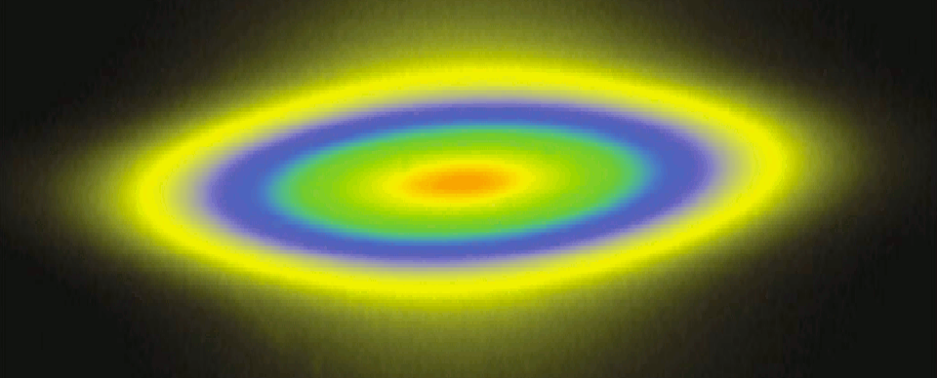
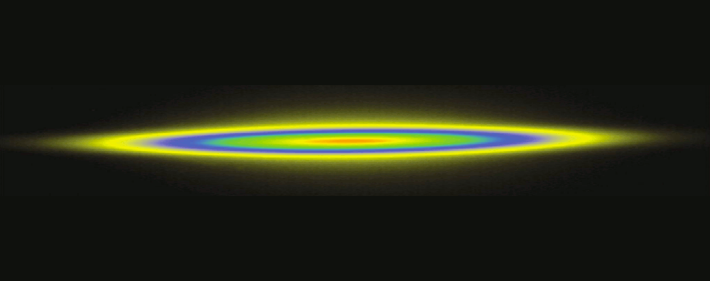
Coupling correction via Resonance Driving Terms
Misconception #2: coupling is a linear problem
The lower the vertical dispersion and the coupling RDTs, the smaller the vertical emittances
and beam tilt
σ_{xy} ~ S₋²,S₊²
a₂=0.7 (2010) , 0.4 (2011)
a₁+a₂=1
Different weights on f₁₀₀₁ and f₁₀₁₀ tried, best if equal.

Slide 44
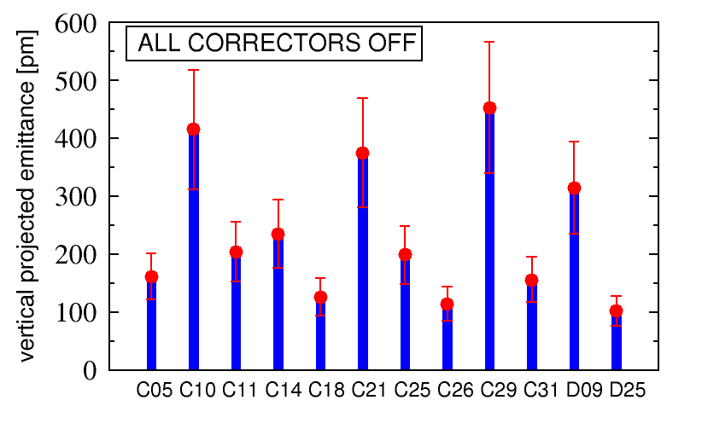
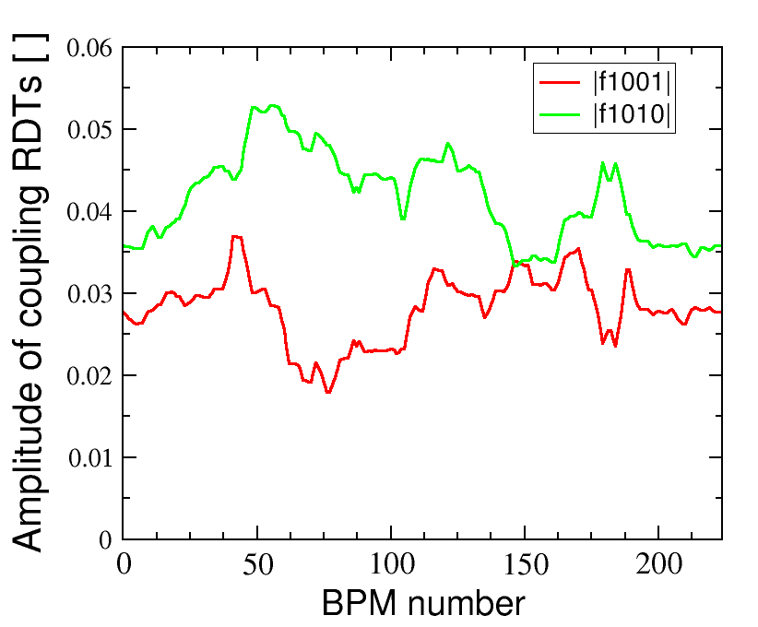
Misconception #2: coupling is a linear problem
First RDT correction: January 16th 2010
All skew correctors OFF: ε_{y} ±δε_{y} = 237 ± 122 pm

Slide 45
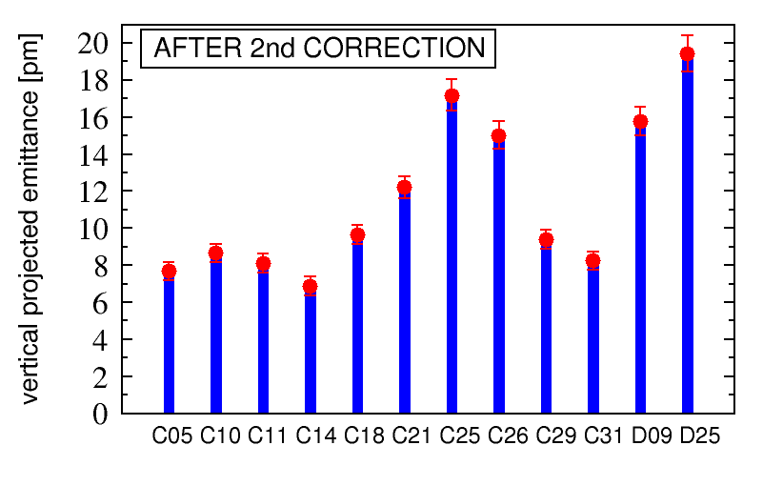
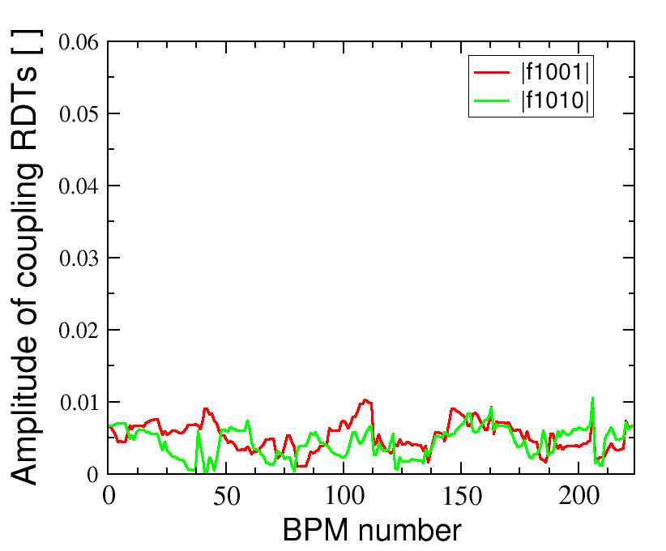
Misconception #2: coupling is a linear problem
First RDT correction: January 16th 2010
After RDT correction: ε_{y} ±δε_{y} = 11.5 ± 4.3 pm
First RDT correction: January 16th 2010
After ORM measur. and RDT correction: ε_{y} ±δε_{y} = 11.5 ± 4.3 pm
~20 min. for ORM
a few seconds for RDT correction

Slide 46
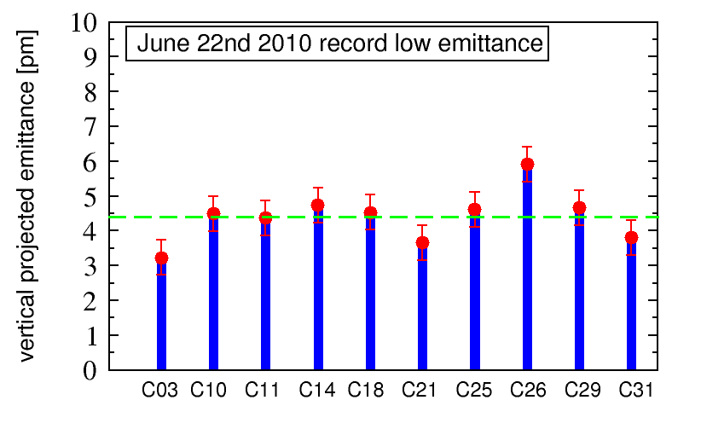
Misconception #2: coupling is a linear problem
ESRF’s temporary record-low vertical emittance: 22/06/10
ε_{y} ±δε_{y} = 4.4 ± 0.7 pm

Slide 47
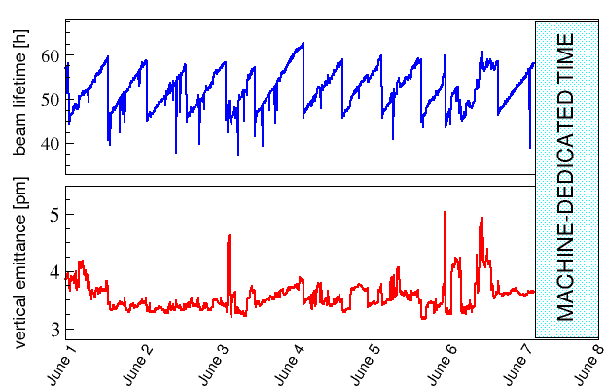
2011: Towards ultra-small vertical emittance
Misconception #2: coupling is a linear problem
2011, with 64 skew quad correctors

Slide 48
Outlines
Misconception #1: In the presence of coupling we deal with vertical emittances (plural is not a typo)
Misconception #2: Coupling correction is a linear problem not needing CPU-intense random/genetic/non-linear optimizers
Misconception #3: Guignard formulas do not apply to modern synchrotron light sources and damping rings
Misconception #4: “indirect measurements” of vertical emittance should be avoided

Slide 49
Misconception #3: Guignard formula
@ ESRF before correction
|f₁₀₁₀| > |f₁₀₀₁| ( i.e. S₊ > S₋)
sum resonance > difference resonance

Slide 50
Misconception #3: Guignard formula
@ ESRF after correction
|f₁₀₁₀| ~ |f₁₀₀₁| ( i.e. S₊ ~ S₋)
sum resonance ~ difference resonance

Slide 51
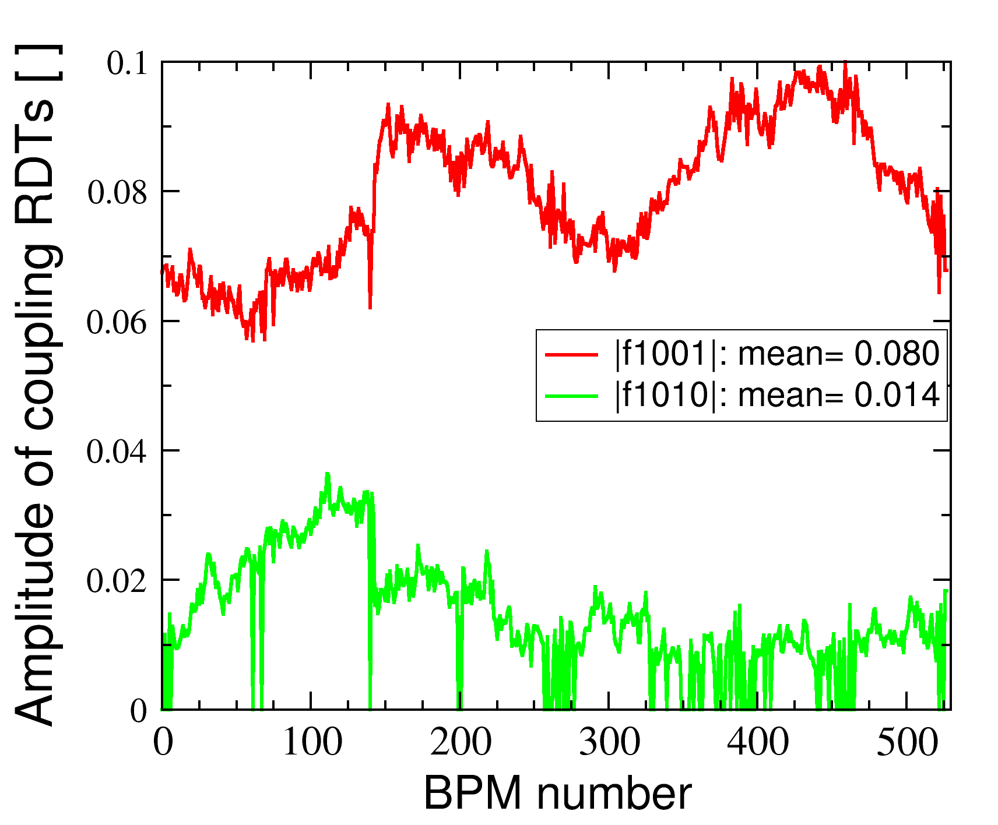
Misconception #3: Guignard formula
@ RHIC after correction
@ ESRF after correction
|f₁₀₁₀| << |f₁₀₀₁| ( i.e. S₊ << S₋)
sum resonance <<
difference resonance
|f₁₀₁₀| ~ |f₁₀₀₁| ( i.e. S₊ ~ S₋)
sum resonance ~ difference resonance

Slide 52
The coupling sum resonance
Misconception #3: Guignard formula
Lepton machine => low hor. emittance => hor. focusing stronger than vertical => Qx >> Qy (@ ESRF Qx=36.44 , Qy=13.39 , Qx-Qy=23.05 )
Low-emitt. Rings: |f₁₀₁₀| ~ |f₁₀₀₁| ( i.e. S₊ ~ S₋ )=> |C⁺|~|C⁻ |

Slide 53
The coupling sum resonance
Misconception #3: Guignard formula
Lepton machine => low hor. emittance => hor. focusing stronger than vertical => Qx >> Qy (@ ESRF Qx=36.44 , Qy=13.39 , Qx-Qy=23.05 )
Hadron machine => almost “round” beam (Ex~Ey) => similar hor. & ver. focusing => Qx ~ Qy (like the CERN SPS Qx=26.18 , Qy=26.22 , Qx-Qy=-0.04 )
Low-emitt. Rings: |f₁₀₁₀| ~ |f₁₀₀₁| ( i.e. S₊ ~ S₋ )=> |C⁺|~|C⁻ |
Hadron Rings: |f₁₀₁₀| << |f₁₀₀₁| ( i.e. S₊ << S₋ )=> |C⁺|<<|C⁻ |

Slide 54
The coupling sum resonance
Misconception #3: Guignard formula
Lepton machine => low hor. emittance => hor. focusing stronger than vertical => Qx >> Qy (@ ESRF Qx=36.44 , Qy=13.39 , Qx-Qy=23.05 )
Hadron machine => almost “round” beam (Ex~Ey) => similar hor. & ver. focusing => Qx ~ Qy (like the CERN SPS Qx=26.18 , Qy=26.22 , Qx-Qy=-0.04 )
The same applies to booster rings (@ ESRF Qx=11.75 , Qy=9.65 , @ BESY II Qx=4.42 , Qy=3.38 )
Low-emitt. Rings: |f₁₀₁₀| ~ |f₁₀₀₁| ( i.e. S₊ ~ S₋ )=> |C⁺|~|C⁻ |
Hadron Rings: |f₁₀₁₀| << |f₁₀₀₁| ( i.e. S₊ << S₋ )=> |C⁺|<<|C⁻ |

Slide 55
The coupling sum resonance
Misconception #3: Guignard formula
Lepton machine => low hor. emittance => hor. focusing stronger than vertical => Qx >> Qy (@ ESRF Qx=36.44 , Qy=13.39 , Qx-Qy=23.05 )
Hadron machine => almost “round” beam (Ex~Ey) => similar hor. & ver. focusing => Qx ~ Qy (like the CERN SPS Qx=26.18 , Qy=26.22 , Qx-Qy=-0.04 )
The same applies to booster rings (@ ESRF Qx=11.75 , Qy=9.65 , @ BESY II Qx=4.42 , Qy=3.38 )
Low-emitt. Rings: |f₁₀₁₀| ~ |f₁₀₀₁| ( i.e. S₊ ~ S₋ )=> |C⁺|~|C⁻ |
Hadron Rings: |f₁₀₁₀| << |f₁₀₀₁| ( i.e. S₊ << S₋ )=> |C⁺|<<|C⁻ |
WHY?

Slide 56
The coupling sum resonance
Misconception #3: Guignard formula

Slide 57
The coupling sum resonance
Misconception #3: Guignard formula

Slide 58
The coupling sum resonance
Misconception #3: Guignard formula

Slide 59
The coupling sum resonance
Misconception #3: Guignard formula
Σϕ
Δϕ

Slide 60
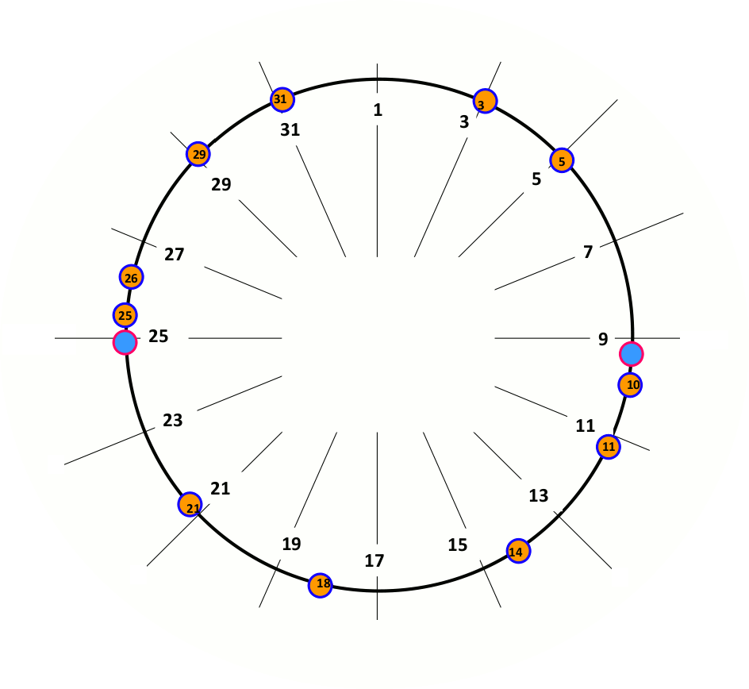
Low-emittance rings [Q_{x}>Q_{y}]
Misconception #3: Guignard formula
Q_{x}=20.44
ΣQ=30.76
ΔQ=10.12
Q_{y}=10.32
Σϕ=26.91
Δϕ= 8.85
ϕ_{x}=17.88
ϕ_{x}=2.55
Σϕ=3.84
Δϕ=1.26
ϕ_{y}=9.03
ϕ_{y}=1.29
Σϕ=23.07
Δϕ= 7.49
ϕ_{x}=15.33
ϕ_{x}=5.11
Σϕ=7.69
Δϕ=2.53
ϕ_{y}=7.74
ϕ_{y}=2.58
Σϕ=19.22
Δϕ= 6.32
ϕ_{x}=12.77
ϕ_{x}=7.66
Σϕ=11.53
Δϕ= 3.79
ϕ_{y}=6.45
ϕ_{y}=3.87
ϕ_{x}=10.22
Σϕ=15.38
Δϕ= 5.06
ϕ_{y}=5.16

Slide 61
Low-emittance rings [Q_{x}>Q_{y}]
Misconception #3: Guignard formula
Q_{x}=20.44
ΣQ=30.76
ΔQ=10.12
Q_{y}=10.32
Σϕ=26.91
Δϕ= 8.85
ϕ_{x}=17.88
ϕ_{x}=2.55
Σϕ=3.84
Δϕ=1.26
ϕ_{y}=9.03
ϕ_{y}=1.29
Σϕ=23.07
Δϕ= 7.49
ϕ_{x}=15.33
ϕ_{x}=5.11
Σϕ=7.69
Δϕ=2.53
ϕ_{y}=7.74
ϕ_{y}=2.58
Σϕ=19.22
Δϕ= 6.32
ϕ_{x}=12.77
ϕ_{x}=7.66
Σϕ=11.53
Δϕ= 3.79
ϕ_{y}=6.45
ϕ_{y}=3.87
ϕ_{x}=10.22
Σϕ=15.38
Δϕ= 5.06
ϕ_{y}=5.16

Slide 62
Low-emittance rings [Q_{x}>Q_{y}]
Misconception #3: Guignard formula
Q_{x}=20.44
ΣQ=30.76
ΔQ=10.12
Q_{y}=10.32
The same for both
Σϕ
ϕ_{y}=7.74
ϕ_{y}=2.58
Δϕ
The sum Σ-term oscillates 3 times faster than difference Δ-term, only

Slide 63
Low-emittance rings [Q_{x}>Q_{y}]
Misconception #3: Guignard formula
Q_{x}=20.44
ΣQ=30.76
ΔQ=10.12
Q_{y}=10.32
The same for both
Σϕ
ϕ_{y}=7.74
ϕ_{y}=2.58
Δϕ
The sum Σ-term oscillates 3 times faster than difference Δ-term, only
|C⁺|~|C⁻|

Slide 64
Hadron rings [Q_{x}~Q_{y}]
Misconception #3: Guignard formula
Q_{x}=26.18
ΣQ=52.40
ΔQ=-0.04
Q_{y}=26.22
Σϕ=45.75
Δϕ=-0.03
ϕ_{x}=22.89
ϕ_{x}=3.27
Σϕ= 6.55
Δϕ=-0.01
ϕ_{y}=22.86
ϕ_{y}=3.28
Σϕ=39.20
Δϕ=-0.03
ϕ_{x}=19.62
ϕ_{x}=6.55
Σϕ=13.10
Δϕ=-0.01
ϕ_{y}=19.58
ϕ_{y}=6.56
Σϕ=32.75
Δϕ=-0.03
ϕ_{x}=16.36
ϕ_{x}=9.82
Σϕ=19.66
Δϕ=-0.02
ϕ_{y}=16.39
ϕ_{y}=9.84
ϕ_{x}=13.09
Σϕ=26.20
Δϕ=-0.02
ϕ_{y}=13.11

Slide 65
Hadron rings [Q_{x}~Q_{y}]
Misconception #3: Guignard formula
Q_{x}=26.18
ΣQ=52.40
ΔQ=-0.04
Q_{y}=26.22
Σϕ=45.75
Δϕ=-0.03
ϕ_{x}=22.89
ϕ_{x}=3.27
Σϕ= 6.55
Δϕ=-0.01
ϕ_{y}=22.86
ϕ_{y}=3.28
Σϕ=39.20
Δϕ=-0.03
ϕ_{x}=19.62
ϕ_{x}=6.55
Σϕ=13.10
Δϕ=-0.01
ϕ_{y}=19.58
ϕ_{y}=6.56
Σϕ=32.75
Δϕ=-0.03
ϕ_{x}=16.36
ϕ_{x}=9.82
Σϕ=19.66
Δϕ=-0.02
ϕ_{y}=16.39
ϕ_{y}=9.84
ϕ_{x}=13.09
Σϕ=26.20
Δϕ=-0.02
ϕ_{y}=13.11

Slide 66
Hadron rings [Q_{x}~Q_{y}]
Misconception #3: Guignard formula
Q_{x}=26.18
ΣQ=52.40
ΔQ=-0.04
Q_{y}=26.22
The same for both
Σϕ
ϕ_{y}=7.74
ϕ_{y}=2.58
Δϕ
=1
The sum Σ-term oscillates 52 times, while the difference Δ-term does not
|C⁺|<<|C⁻|

Slide 67
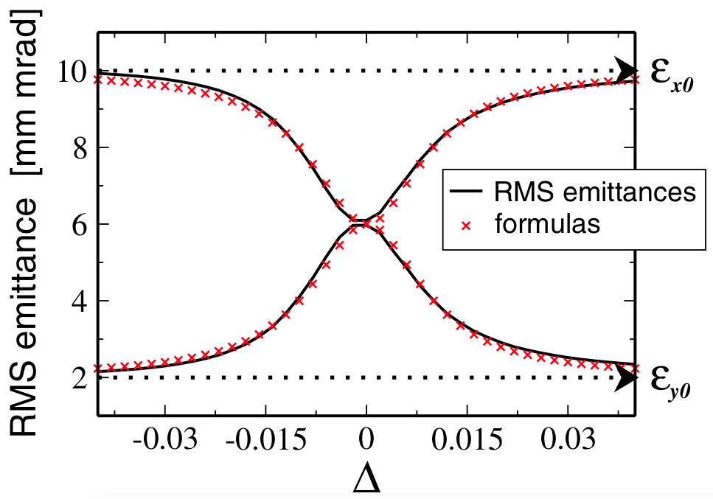
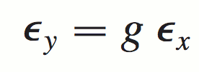
Misconception #3: Guignard formula
Guignard formula (fixed tunes, i.e. Δ=Q_{x}-Q_{y} constant in time)
WARNING: the formula is only valid for negligible sum resonance, i.e. |C⁻| >> |C⁺|, hence not for modern synchrotron light sources

Slide 68
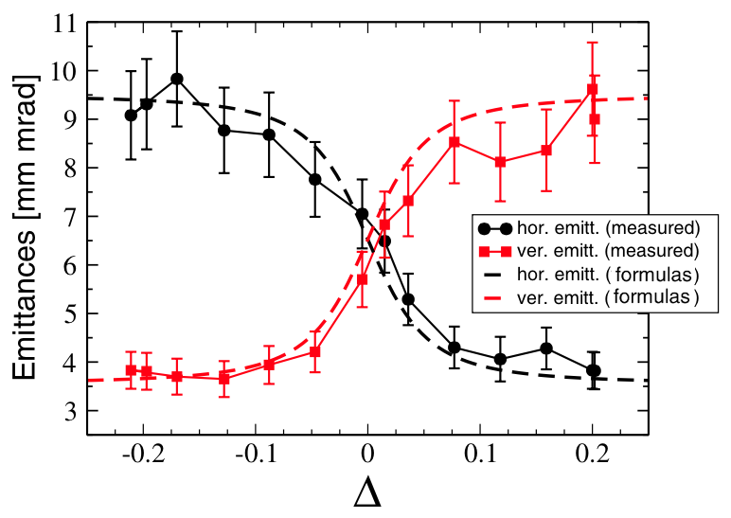
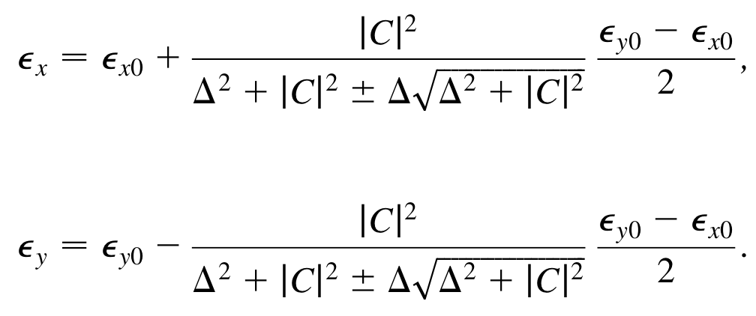
Misconception #3: Guignard formula
Metral formula (tunes varying in time, i.e. Δ(t)=Q_{x}(t)-Q_{y}(t) , resonance crossing)
WARNING: the formula is only valid for negligible sum resonance, i.e. |C⁻| >> |C⁺|, hence not for modern synchrotron light sources
CERN PS, PRSTAB 10, 064003 (2007)

Slide 69
Misconception #3: Guignard formula
Metral formula (tunes varying in time, i.e. Δ(t)=Q_{x}(t)-Q_{y}(t) , resonance crossing)
WARNING: the formula is only valid for negligible sum resonance, i.e. |C⁻| >> |C⁺|, hence not for modern synchrotron light sources
CERN PS, PRSTAB 10, 064003 (2007)
Though it can still apply to light source booster rings (|C⁻| >> |C⁺|), see Peter Kuske, WEOAA01 IPAC2016

Slide 70
Outlines
Misconception #1: In the presence of coupling we deal with vertical emittances (plural is not a typo)
Misconception #2: Coupling correction is a linear problem not needing CPU-intense random/genetic/non-linear optimizers
Misconception #3: Guignard formulas do not apply to modern synchrotron light sources and damping rings
Misconception #4: “indirect measurements” of vertical emittance should be avoided

Slide 71
Caution with Guignard’s formula
Misconception #4: “indirect measurements” of ε_{y}
At very low coupling ε_{y} may be smaller than monitor/camera resolution and hence non measurable.

Slide 72
Caution with Guignard’s formula
Misconception #4: “indirect measurements” of ε_{y}
At very low coupling ε_{y} may be smaller than monitor/camera resolution and hence non measurable.
One may be then tempted to use Guignard’s formula
The “large” ε_{x} easier to measure and “g” evaluated from tune measurements (closest tune approach). Δ = Qx-Qy (fractional part, |C⁻| is the difference resonance stop band.

Slide 73
Caution with Guignard’s formula
Misconception #4: “indirect measurements” of ε_{y}
At very low coupling ε_{y} may be smaller than monitor/camera resolution and hence non measurable.
One may be then tempted to use Guignard’s formula
The “large” ε_{x} easier to measure and “g” evaluated from tune measurements (closest tune approach). Δ = Qx-Qy (fractional part, |C⁻| is the difference resonance stop band.
But the formula is only valid for:
sum resonance negligible, i.e. |C⁻| >> |C⁺|
Vert. dispersion Dy contribution to ε_{y} << betatron coupling contribution

Slide 74
Caution with Guignard’s formula
Misconception #4: “indirect measurements” of ε_{y}
At very low coupling ε_{y} may be smaller than monitor/camera resolution and hence non measurable.
One may be then tempted to use Guignard’s formula
The “large” ε_{x} easier to measure and “g” evaluated from tune measurements (closest tune approach). Δ = Qx-Qy (fractional part, |C⁻| is the difference resonance stop band.
But the formula is only valid for:
sum resonance negligible, i.e. |C⁻| << |C⁺|
Vert. dispersion Dy contribution to ε_{y} > betatron coupling contribution
@ ESRF SR
9E-4
3E-3
0.94 pm
0.65 pm

Slide 75
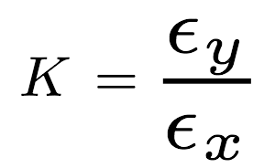
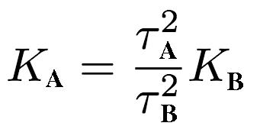
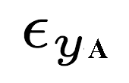
Caution with lifetime measurement (1)
Misconception #4: “indirect measurements” of ε_{y}
At very low coupling ε_{y} may be smaller than monitor/camera resolution and hence non measurable.
One may use the reduction of the Touschek lifetime

Slide 76
Caution with lifetime measurement (1)
Misconception #4: “indirect measurements” of ε_{y}
At very low coupling ε_{y} may be smaller than monitor/camera resolution and hence non measurable.
One may use the reduction of the Touschek lifetime
This approach is valid under the assumption that the lifetime reduction is exclusively induced by the Touschek effect.
However, the sum resonance ( |C⁺| ) is unstable and may account for lower-than-expected lifetime with larger ε_{y} , if inadvertently enhanced during coupling correction.

Slide 77
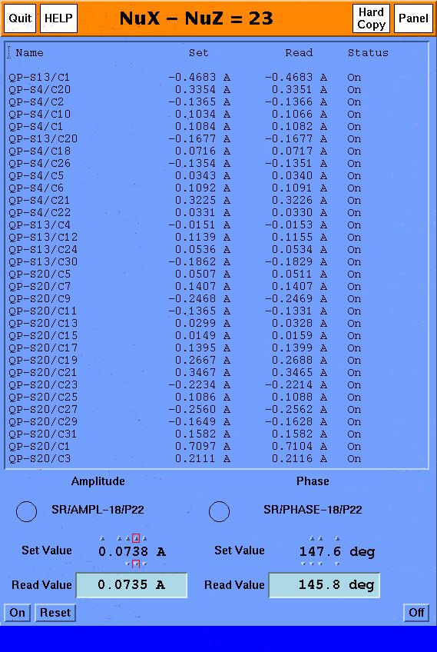
Caution with lifetime measurement (1)
Misconception #4: “indirect measurements” of ε_{y}
At very low coupling ε_{y} may be smaller than monitor/camera resolution and hence non measurable.
One may use the reduction of the Touschek lifetime
This approach is valid under the assumption that the lifetime reduction is exclusively induced by the Touschek effect.
However, the sum resonance ( |C⁺| ) is unstable and may account for lower-than-expected lifetime with larger ε_{y} , if inadvertently enhanced during coupling correction.
At the ESRF, while trimming skews, it has been sometimes observed that:

Slide 78
Caution with lifetime measurement (1)
Misconception #4: “indirect measurements” of ε_{y}
At very low coupling ε_{y} may be smaller than monitor/camera resolution and hence non measurable.
One may be then tempted to use Touschek-lifetime reduction
This approach is valid under the assumption that the lifetime reduction is exclusively induced by the Touschek effect.
However, the sum resonance ( |C⁺| ) is unstable and may account for lower-than-expected lifetime with larger ε_{y} , if inadvertently enhanced during coupling correction.
At the ESRF, while trimming skews, it has been sometimes observed that:
1. reducing |C⁻|, both Ey and lifetime decrease (stronger Touschek)

Slide 79
Caution with lifetime measurement (1)
Misconception #4: “indirect measurements” of ε_{y}
At very low coupling ε_{y} may be smaller than monitor/camera resolution and hence non measurable.
One may be then tempted to use Touschek-lifetime reduction
This approach is valid under the assumption that the lifetime reduction is exclusively induced by the Touschek effect.
However, the sum resonance ( |C⁺| ) is unstable and may account for lower-than-expected lifetime with larger ε_{y} , if inadvertently enhanced during coupling correction.
At the ESRF, while trimming skews, it has been sometimes observed that:
1. reducing |C⁻|, both Ey and lifetime decrease (stronger Touschek)
2. increasing |C⁺|, Ey increases whereas lifetime decreases (sum resonance stronger than Touschek ?)

Slide 80
Caution with lifetime measurement (2)
Misconception #4: “indirect measurements” of ε_{y}
At very low coupling ε_{y} may be smaller than monitor/camera resolution and hence non measurable.
One may infer the average ε_{y} via
Touschek-lifetime measurement.

Slide 81
Caution with lifetime measurement (2)
Misconception #4: “indirect measurements” of ε_{y}
At very low coupling ε_{y} may be smaller than monitor/camera resolution and hence non measurable.
One may infer the average ε_{y} via
Touschek-lifetime measurement.
A depends on several RF-related parameters (bunch length, RF acceptance, dynamic aperture).

Slide 82
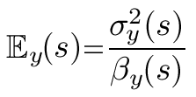
Caution with lifetime measurement (2)
Misconception #4: “indirect measurements” of ε_{y}
At very low coupling ε_{y} may be smaller than monitor/camera resolution and hence non measurable.
One may infer the average ε_{y} via
Touschek-lifetime measurement.
A depends on several RF-related parameters (bunch length, RF acceptance, dynamic aperture).
The emittance in the formula shall be the apparent one, not the model eigen-emittance Ev

Slide 83
Caution with lifetime measurement (2)
Misconception #4: “indirect measurements” of ε_{y}
At very low coupling ε_{y} may be smaller than monitor/camera resolution and hence non measurable.
One may infer the average ε_{y} via
Touschek-lifetime measurement.
A depends on several RF-related parameters (bunch length, RF acceptance, dynamic aperture) and β-functions
Actually, it shall be the apparent emittance averaged along the low-beta regions of the ring (those with the high scattering rate contributing the most the lifetime integral), not the model eigen-emittance Ev

Slide 84
Caution with lifetime measurement (2)
model eigen-emittance Ev= 9 pm
Vs
meas. avg. apparent emittance <E_{y}>=16 pm
Misconception #4: “indirect measurements” of ε_{y}
At very low coupling ε_{y} may be smaller than monitor/camera resolution and hence non measurable.
One may infer the average ε_{y} via
Touschek-lifetime measurement.
A depends on several RF-related parameters (bunch length, RF acceptance, dynamic aperture).
Actually, it shall be the apparent emittance averaged along the low-beta regions of the ring (those with the high scattering rate contributing the most the lifetime integral) , not the model eigen-emittance Ev

Slide 85
Caution with lifetime measurement (2)
Misconception #4: “indirect measurements” of ε_{y}
At very low coupling ε_{y} may be smaller than monitor/camera resolution and hence non measurable.
One may infer the average ε_{y} via
Touschek-lifetime measurement.
A depends on several RF-related parameters (bunch length, RF acceptance, dynamic aperture).
It actually shall be the apparent emittance averaged along the low-beta regions of the ring (those with the high scattering rate contributing the most the lifetime integral), not the model eigen-emittance Ev
Measured <Ey> not model eigen-emittance Ev !!

Slide 86
Caution with lifetime measurement (2)
Misconception #4: “indirect measurements” of ε_{y}
At very low coupling ε_{y} may be smaller than monitor/camera resolution and hence non measurable.
Conditions | 200 mA m 7/8 no Single Bunch |  | 01-Feb-11
Measurements
 | Model eigen-emittance | [pm] | 2.4
 | Vert Emitt. <IAX> | [pm] | 4.2±1.2
 | Vert Emitt. ID25-b | [pm] | 3.64
 | Vert Emitt. ID25-XRL | [pm] | 3.75
 | Vert Emitt. D9-a | [pm] | 7.1
 | Total Lifetime | [h] | 51.5
Processing
 | Touschek Prolongated Vert Emitt | [pm] | 3.9
 | Vacuum Lifetime | [h] | 170
 | Touschek Lifetime | [h] | 74
Estimation
 | Total Lifetime @ 2pm | [h] | 40.4

Slide 87
Caution with lifetime measurement (2)
Misconception #4: “indirect measurements” of ε_{y}
At very low coupling ε_{y} may be smaller than monitor/camera resolution and hence non measurable.
Conditions | 200 mA m 7/8 no Single Bunch |  | 01-Feb-11
Measurements
 | Model eigen-emittance | [pm] | 2.4
 | Vert Emitt. <IAX> | [pm] | 4.2±1.2
 | Vert Emitt. ID25-b | [pm] | 3.64
 | Vert Emitt. ID25-XRL | [pm] | 3.75
 | Vert Emitt. D9-a | [pm] | 7.1
 | Total Lifetime | [h] | 51.5
Processing
 | Touschek Prolongated Vert Emitt | [pm] | 3.9
 | Vacuum Lifetime | [h] | 170
 | Touschek Lifetime | [h] | 74
Estimation
 | Total Lifetime @ 2pm | [h] | 40.4
OK!

Slide 88
Caution with lifetime measurement (2)
Misconception #4: “indirect measurements” of ε_{y}
At very low coupling ε_{y} may be smaller than monitor/camera resolution and hence non measurable.
Conditions | 200 mA m 7/8 no Single Bunch |  | 01-Feb-11
Measurements
 | Model eigen-emittance | [pm] | 2.4
 | Vert Emitt. <IAX> | [pm] | 4.2±1.2
 | Vert Emitt. ID25-b | [pm] | 3.64
 | Vert Emitt. ID25-XRL | [pm] | 3.75
 | Vert Emitt. D9-a | [pm] | 7.1
 | Total Lifetime | [h] | 51.5
Processing
 | Touschek Prolongated Vert Emitt | [pm] | 3.9
 | Vacuum Lifetime | [h] | 170
 | Touschek Lifetime | [h] | 74
Estimation
 | Total Lifetime @ 2pm | [h] | 40.4
NO!!

Slide 89
Caution with lifetime measurement (2)
Misconception #4: “indirect measurements” of ε_{y}
At very low coupling ε_{y} may be smaller than monitor/camera resolution and hence non measurable.
Touschek lifetime measurement @ ESRF
Conditions | 200 mA m 7/8 no Single Bunch |  | 01-Feb-11
Measurements
 | Model eigen-emittance | [pm] | 2.4
 | Vert Emitt. <IAX> | [pm] | 4.2±1.2
 | Vert Emitt. ID25-b | [pm] | 3.64
 | Vert Emitt. ID25-XRL | [pm] | 3.75
 | Vert Emitt. D9-a | [pm] | 7.1
 | Total Lifetime | [h] | 51.5
Processing
 | Touschek Prolongated Vert Emitt | [pm] | 3.9
 | Vacuum Lifetime | [h] | 170
 | Touschek Lifetime | [h] | 74
Estimation
 | Total Lifetime @ 2pm | [h] | 40.4
large <Ey> with white noise
rather than with coupling to keep βx, βy & δEy constant
NO!!
Measured <Ey> not model eigen-emittance Ev !!

Slide 90
Outlines
Misconception #1: In the presence of coupling we deal with vertical emittances (plural is not a typo)
Misconception #2: Coupling correction is a linear problem not needing CPU-intense random/genetic/non-linear optimizers
Misconception #3: Guignard formulas do not apply to modern synchrotron light sources and damping rings
Misconception #4: “indirect measurements” of vertical emittance should be avoided

